Slide 1


sMAP – a Simple Measurement and Actuation Profile for Physical Information
Stephen Dawson-Haggerty, Xiaofan Jiang,
Gilman Tolle, Jorge Ortiz, and David Culler
Computer Science Division
University of California, Berkeley
© 2010 All rights reserved

Slide 2
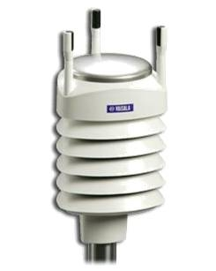
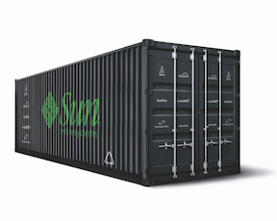
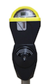
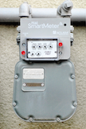
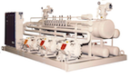
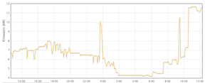
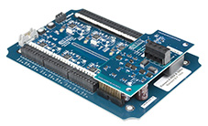
Physical data is everywhere
Information from the world
Timeseries
Buildings
Wed Oct 27 12:35:00 2010,92.8
Wed Oct 27 12:40:00 2010,91.6
Wed Oct 27 12:45:00 2010,92.76
Wed Oct 27 12:50:00 2010,89.445
Wed Oct 27 12:55:00 2010,95.0
Wed Oct 27 13:00:00 2010,94.005
Wed Oct 27 13:05:00 2010,96.3
Wed Oct 27 13:10:00 2010,91.61
Wed Oct 27 13:15:00 2010,97.475
Wed Oct 27 13:20:00 2010,95.825
Core HVAC
Shade or Passive Solar
Natural Ventilation
Task Lighting & Conditioning
Ambient Lighting
Perimeter HVAC
Power Load Mgmt
BMS
Transport
Light
HVAC
Electrical
Notes:
What is physical, data, everywhere

Slide 3
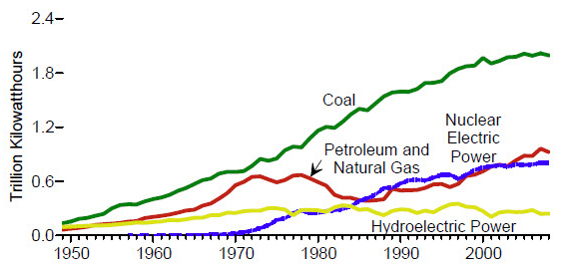
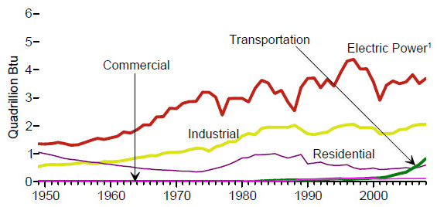
Why buildings?
72% of electrical consumption, 40% of total consumption, 50% with construction, 42% of GHG footprint
Commercial building consumption 2x 1980-2000, 1.5x more by 2025 [NREL]
Where the coal is used
The prime target of opportunity for renewable supplies
Electricity source
Renewable energy consumption

Slide 4

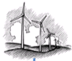
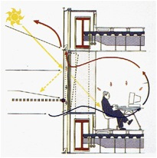
Cyber / Physical Building
Human-Building Interface
Control Plan and Schedule
External
Building Integrated
Operating System
Activity/Usage
Streams
Occupant Demand
Activity Models
Multi-Objective Model-Driven Control
Pervasive Sensing
Fault, Attack, Anomaly Detect &Management
Process Loads
BMS
Physical Models
PIB
Legacy Instrumentation & Control Interfaces
Transport
Electrical
BIM
Light
HVAC
Cyber
Physical
Building

Slide 5
“Smart Buildings”
Protocol | Year | Network | Example Applications
Modbus | 1979 | RS-485, TCP/IP | Panel monitoring, alarms
Fieldbus/HART | 1988 | various | Industrial Control
BACnet | 1995 | ARCNET, Ethernet, IP, RS-232, etc. | HVAC, Lighting, Fire…
WirelessHART | 2007 | 802.15.4e | Industrial control, wire replacement
Zigbee SEP 2.0 | 2011? | 802.15.4 | Plug-load monitoring
HUGE installed/legacy base
Multiple generations of hardware and software in the same building
Typical integration: proprietary vertical Building Management System (BMS)
Data in at the bottom
Data products out at the top
BMS
Electrical
Transport
Light
HVAC
Notes:
Different types of sensors and systems in a building

Slide 6
What is “RSS” for physical data?
Make available diverse information sources
Support publishing to the Internet
Modeling
Personal Feedback
JSON Objects
Continuous Commissioning
Applications
Control
Visualization
Location
Actuation
Storage
Debugging
Authentication
REST API
sMAP
Electrical
Geographical
HTTP/TCP
Water
Occupancy
Physical Information
Environmental
…
Structural
Weather
Actuator
Horizontal Architecture
Vertical Protocol Layering
Notes:
Series of “of course” design decisions
- publishing
- diversity below and above

Slide 7
Design goals
“Uniform” access to real-time
data from an instrument
Open data to a new class of
application developers
RESTful: “representations of resources”
What resources, what do we “represent”?
Dive in: application oriented design
Notes:
REPLACE modbus, and all that
sMAP is not a database
a PARTICULAR protocol, not a generic framework

Slide 8

Example sMAP Interaction
GET /data
[“cory”]
Discover
GET /data/cory
[“sensor”, “meter”]
GET /data/cory/sensor
[“temperature”, “wind”, “humidity”]
GET /data/cory/sensor/temperature/reading
{ “Reading” : 23,
“ReadingTime” : 1288385832,
“ReadingSequence” : 123123 }
Access

Slide 9
Support three things: metering, sensing, actuation
Measuring: instantaneous values | Metering: accumulated values
i.e., temperature | i.e., electricity
Units
Conversion to Engineering Units
Other metadata (?)

Slide 10
Identify sense points and channels
Sense points: physical point of instrumentation
i.e., the sensor; “the weather station”
Channel: single stream of scalars
“temperature”

Slide 11
Map these to HTTP resources
/ # list resource under URI root [GET]
/data # list sense points under resource data [GET]
/ [sense_point] # select a sense points [GET]
/meter # meters provide this service [GET]
/ [channel] # a particular channel [GET]
/reading # meter reading [GET]
/format # calibration and units [GET/POST]
/parameter # sampling parameter [GET/POST]
/profile # history of readings [GET]
➔ Represent units, sampling parameters of the underlying
device, for each channel

Slide 12
What else do we need?
Events
Embedded devices support

Slide 13
Event Reporting: add “callbacks” to HTTP
POST /reporting/create
{ “Period” : 0,
“ReportResource” : “~/data/*/*/*/reading”,
“ReportDeliveryLocation” : “http://www.openbms.org/add/2133”
}
➔ Period “0” means only changes get pushed
Same semantics as a GET on ReportResource
Alternatives are “long get,” webevents/multipart HTTP style
Notes:
Issues working through firewalls + NATS
the rest of the web is going with “long polling”, event-driven servers like twisted or tornado or other epoll-based mechanisms (libevent)

Slide 14
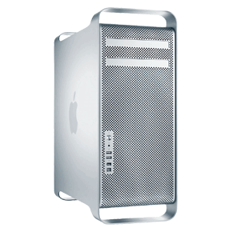
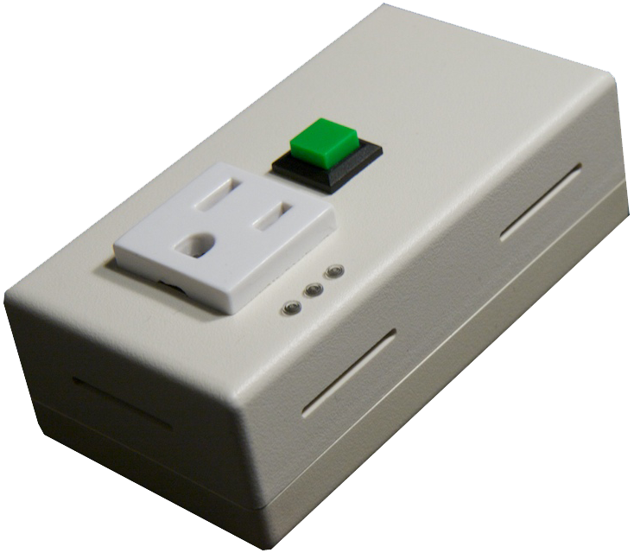
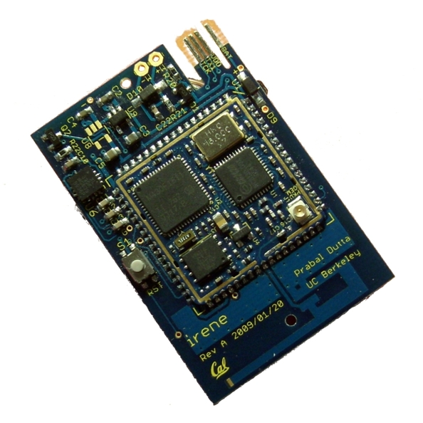
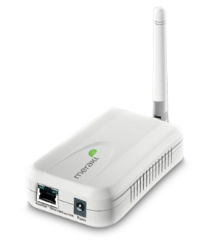
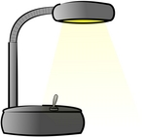
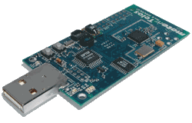
Embedding sMAP
Emerging design pattern: define Internet-scale protocol, use adaptation layer where necessary
sMAP
sMAP
EBHTTP / IPv6 / 6LowPAN Wireless Mesh Network
AC plug meter
Proxy Server
EBHTTP Translation
Edge Router
sMAP
sMAP
Light switch
Temperature/PAR/TSR
Proxy Server
Avro
Translation
➔ Preserve extensibility and self-describing properties of JSON
➔ UDP transport option with stop-and-wait RETX
Edge Router
Edge Router
Notes:
of COURSE you can run this over 6lowpan if you want – previous senSys results

Slide 15
EBHTTP
Avro Encoding
Pack HTTP into a binary message structure: TLV encode headers, body
Apache software foundation project for efficient serialization of JSON: documents reference a schema
Supports most HTTP features but over connectionless UDP: ideal for 6lowpan data collection networks
Additional specification necessary to use it in a RESTful way
GET /.schemas
HTTP 1.0 200 OK
Content-encoding: gzip
drives an architecture
Proxies for accessing end-devices needed for scalability, security anyways
GET /data/*/*/*/reading
HTTP 1.0 200 OK
Content-type: application/avro
X-Avro-Schema: reading
Makes “end-to-end” possible again
Notes:
- example of compression
- not application layer gateway
- similar to the CoAP approach being adopted in the IETF

Slide 16
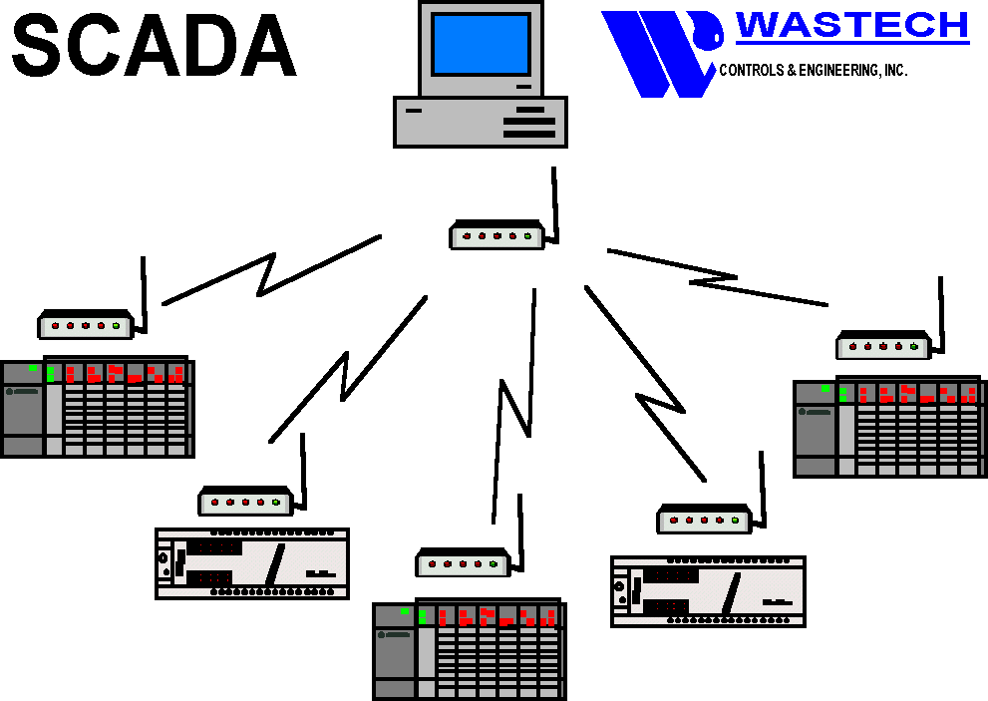
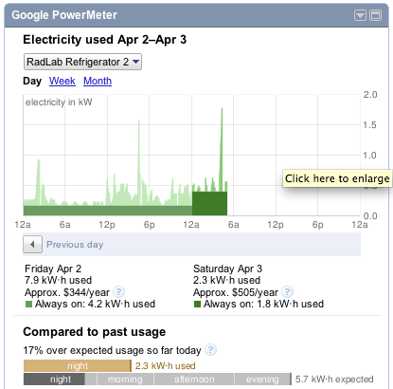
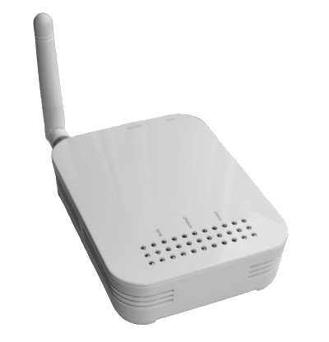
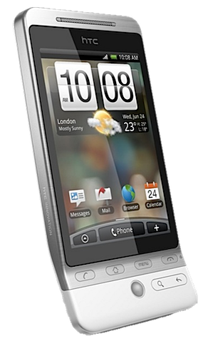
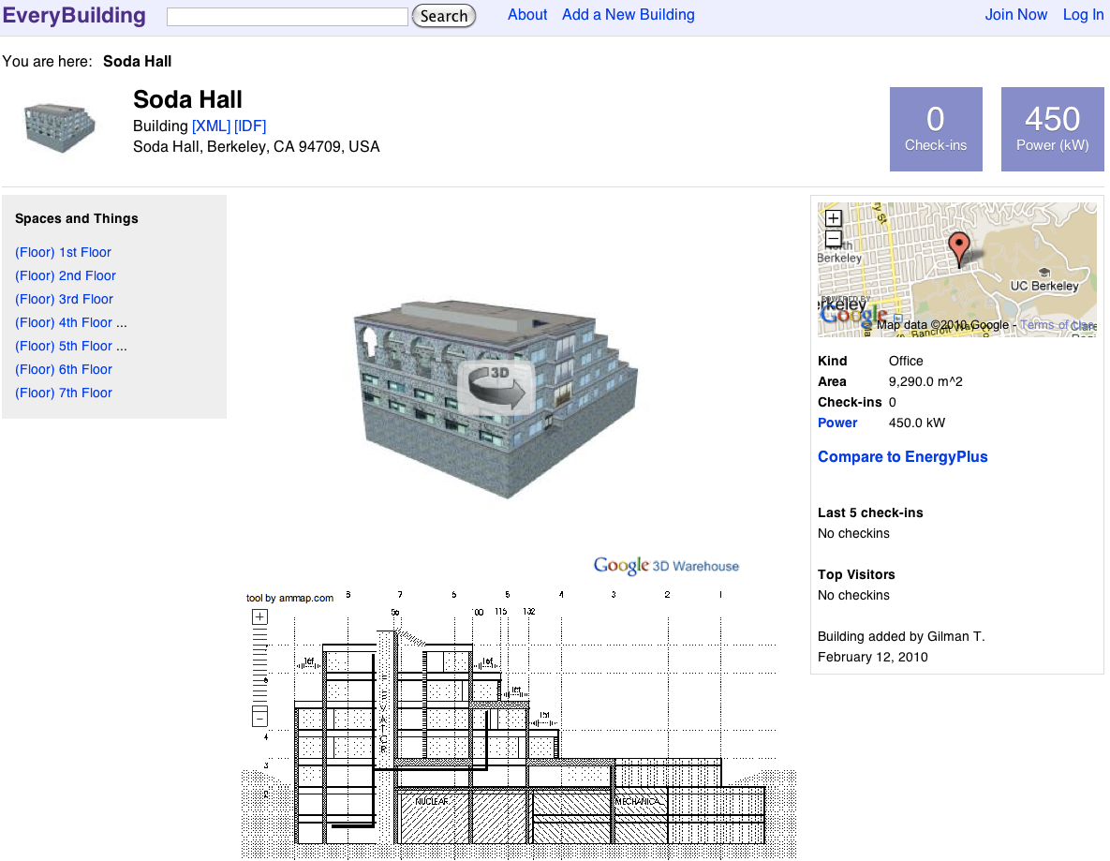
no...
“external” metadata
data repository
credentials database
...anything not an instrument property
That’s it: keep it simple
RS-485
sMAP
Google PowerMeter
sMAP
Internet
Modbus
IPv6 / 6LowPAN Wireless Mesh Network
Cell phone
sMAP
sMAP
sMAP
EveryBuilding
sMAP
Database
Notes:
Only metadata intrinsic to the instrument: model is something you could ship, complete
the key thing is the application

Slide 17
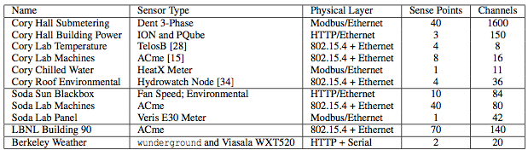
The sMAP library
15 different underlying sensors and stacks
More then 100 instruments, > 200 ACme plug-load meters
4400 channels of high-resolution data
80 sMAP “instances”
together 250 samples/sec
It’s easy: simplest service is ~3 lines of Python
Notes:
Totally different underlying technologies
effectively hide legacy: mention SCADA,
There are other challenges but we solved this one
This is just from one group – everybody has the same problem, too
Also PGE data, SCADA system, Cluster
~100loc sometimes

Slide 18
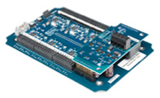
Dent Powerscout 18 sMAP Feed
/ # list resource under URI root [GET]
/data # list sense points under resource data [GET]
/[sense_point] # select a sense points [GET]
/meter # meters provide this service [GET]
/[channel] # a particular channel [GET]
/reading # meter reading [GET]
/format # calibration and units [GET/POST]
/parameter # sampling parameter [GET/POST]
/profile # history of readings [GET]
Sense Point | Description | Channels
A, B, C | Single-phase | real, apparent, reactive power + energy. power factor. current. phase-neutral voltage
AB, BC, AC | Phase-to-phase | voltage
ABC | Whole-circuit | real, apparent, reactive power + energy. power factor. current. phase-neutral voltage, line frequency
Notes:
there are many other smap feeds like this
three phase panel meter

Slide 19
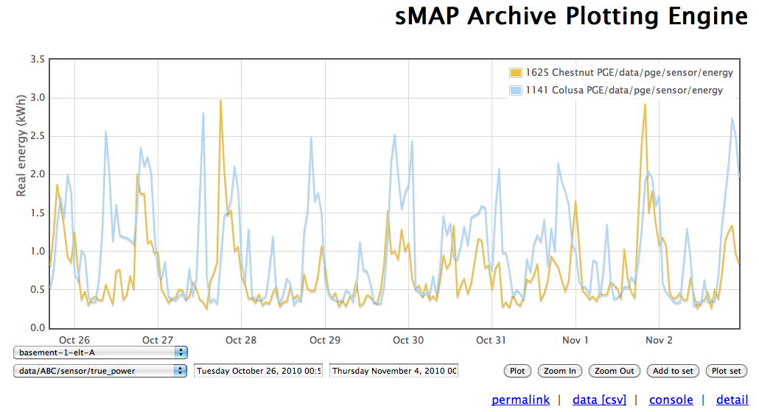
Shared Application: Visualization
Every deployment needs this
http://www.openbms.org/smap/plot/2989/1

Slide 20
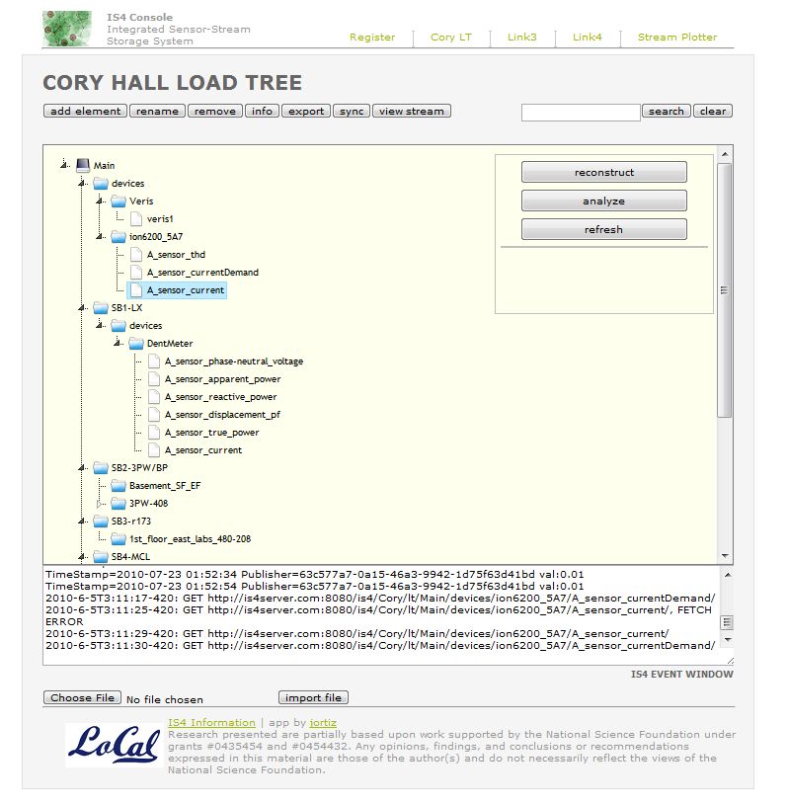
Shared Application: Metadata Repository

Slide 21
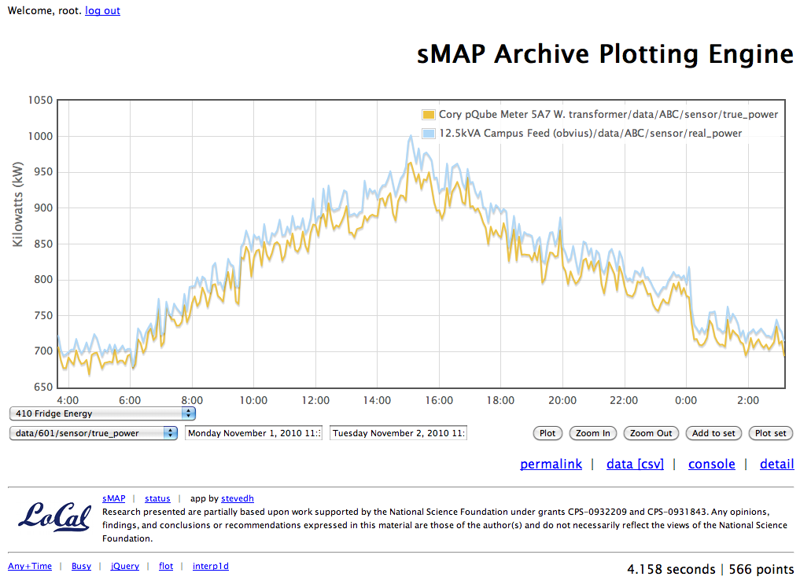
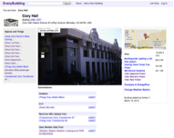
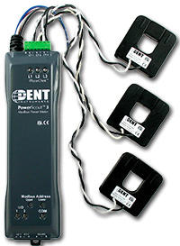
sMAP represents instruments
open source library
lots of independent tools on top
storage
metadata
authentication
location
and more from the community
Temperature/
PAR/TSR
sMAP
Dent circuit meter
sMAP
Archival
EveryBuilding
sMAP
sMAP
Temperature/PAR/TSR
Temperature/PAR/TSR
sMAP
sMAP
Dent circuit meter
Dent circuit meter
Notes:
- represents instruments: and that is the boundary. drives a focus on data since at the end of the day it’s “just” sMAP,, no matter how it gets to you.
- open source: this stuff isn’t that much fun to develop, so we can share components
- the tools become more “portable” too since they accept the same data – out of scope but critical in managing a deployment
- everyone typically wants similar things for their deployments, so now if you just “smap” it, it plugs into the rest of the system. Very different from other deployments I’ve worked on with custom app gateways at the edge. That stuff is important too, but at the end of the day all you want is the data. represents a separation of concerns for application development. this is really just SoA.
- let’s do it ☺

Slide 22
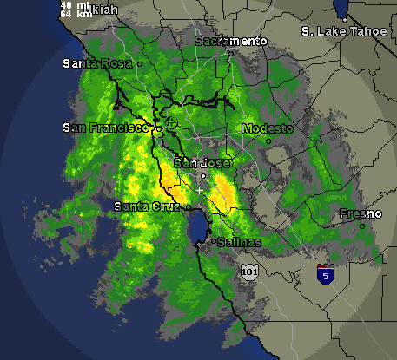
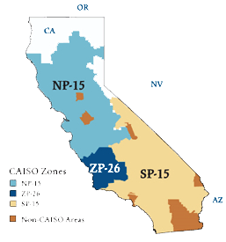
Thank You
sMAP Resources
Applications
California ISO
sMAP Gateway
sMAP
sMAP
sMAP
Google PowerMeter
EBHTTP / IPv6 / 6LowPAN Wireless Mesh Network
Weather
AC plug meter
Vibration / Humidity
Internet
Edge Router
Proxy Server
EBHTTP Translation
Cell phone
sMAP
sMAP
Light switch
Temperature/PAR/TSR
sMAP
sMAP
Every Building
http://www.openbms.org/
http://www.openbms.org/smap/plot
Modbus
RS-485
Dent circuit meter
sMAP Gateway
sMAP Gateway
Database

